Slide 1
Big Data
Stupid Decisions
The Importance Of Measuring
What We Should Be Measuring
Panos @Ipeirotis
Stern School of Business, New York University
“A Computer Scientist in a Business School”
http://behind-the-enemy-lines.com

Slide 2
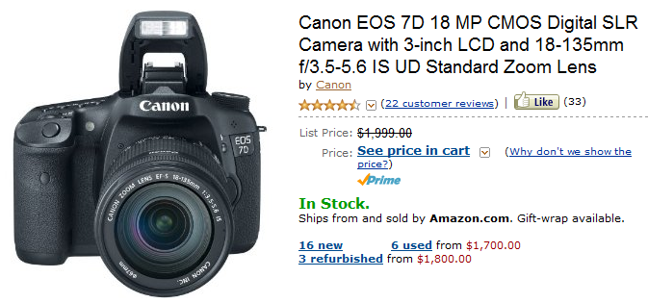
Shopping for a camera

Slide 3
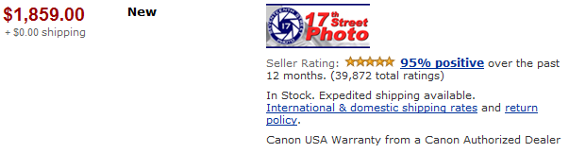
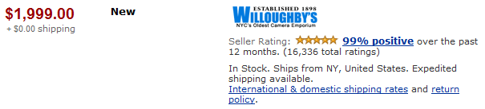
Multiple merchants sell the same camera

Slide 4
Consumers do not always buy the cheapest
✓

Slide 5

Willoughby’s enjoys a 7.5% price premium (= $140)
✓

Slide 6
Price Premium Percentages, Amazon.com
Transaction price compared to competition
Are Sellers Irrational (?)
(charging less)
Are Buyers Irrational (?)
(paying more)
-100%
0%
+100%

Slide 7
Customers care about reputation!

Slide 8
The price of Willoughby’s reputation^{(*)}: $140
✓
(*) vs 17th street photo

Slide 9
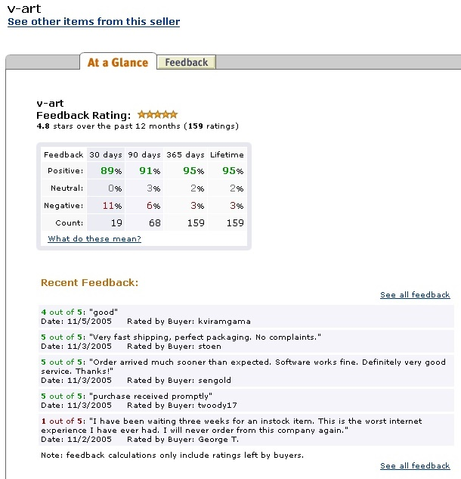
What is reputation?
Factors affecting pricing power
Number of stars
Number of past transactions
…
Text!
My reputation, Iago, my reputation!
-Shakespeare, Othello

Slide 10
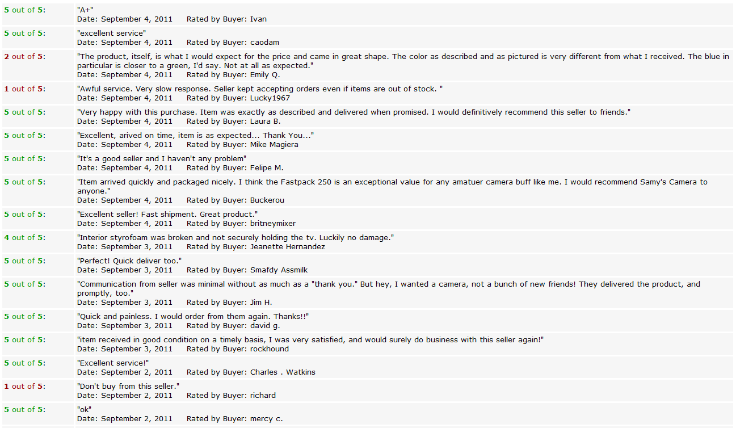

Slide 11
How text affects reputation?

Slide 12
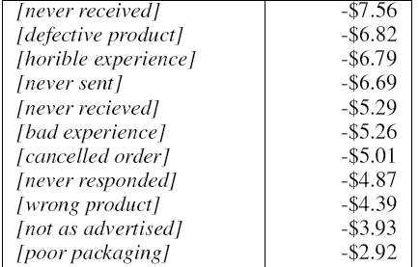
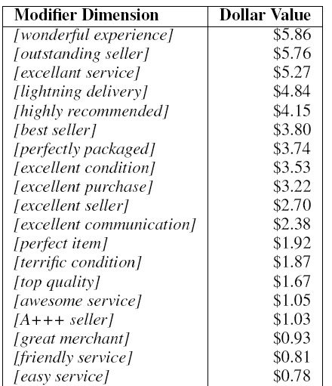
The value of text

Slide 13
The value of text
Misspellings…

Slide 14
good packaging
-0.56%
Negative
Positive?
?

Slide 15
Recommendation Letters:
“He is a good student”
“He works hard”
Decision: Reject

Slide 16
AAA++++ seller
-2.93%
Negative
Positive?
?

Slide 17
People interpret things differently, according to the context

Slide 18
Lesson #1
Adapt to the environment
One size does not fit all!

Slide 19
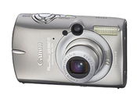
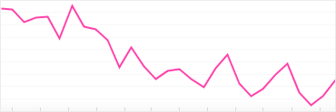
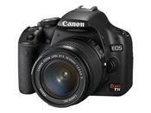
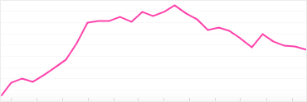

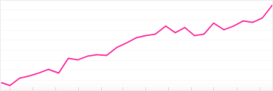
Same idea, different focus:
How reviews (text) affect product sales?

Slide 20
Best camera!
-0.20%
Negative
Positive?
?

Slide 21
Tell me something specific, you shill!

Slide 22

Negative
Positive
?
?

Slide 23
“If this is the worst that can happen…”

Slide 24
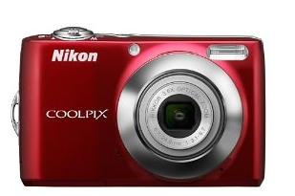
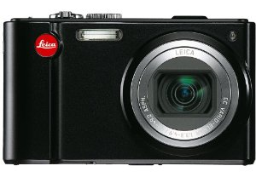
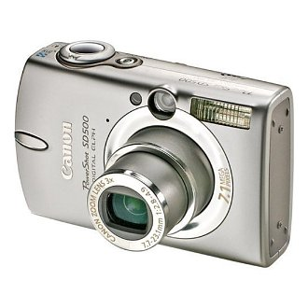
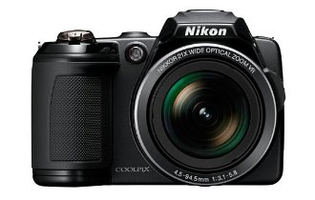
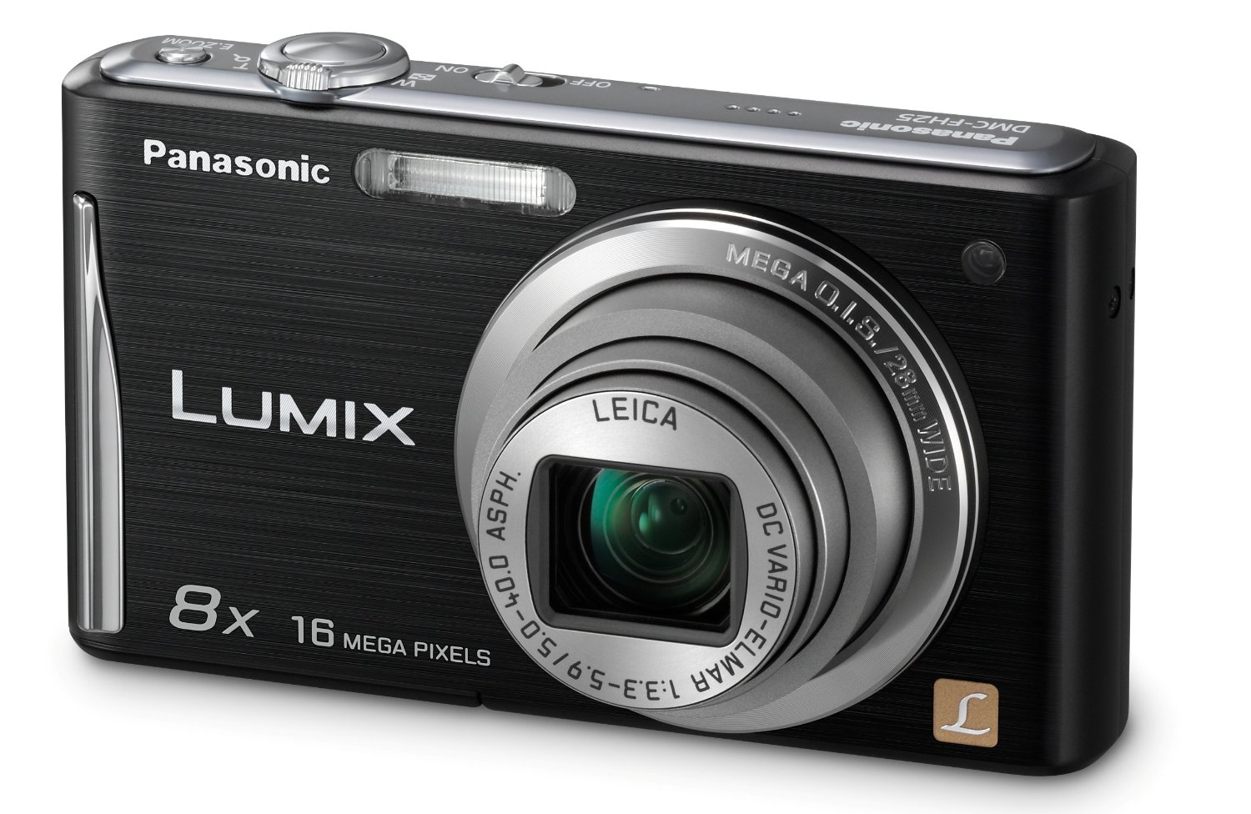
What product features do customers want?

Slide 25
Point-and-Shoot: Lenses, zoom, …

Slide 26
Point-and-Shoot: Lenses, zoom, …

Slide 27
Lesson #2
Not sufficient to know what people say
Measure what people DO

Slide 28
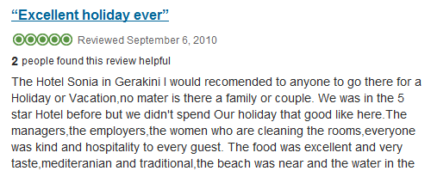
Reviews, Grammar, and Hotel Bookings

Slide 29
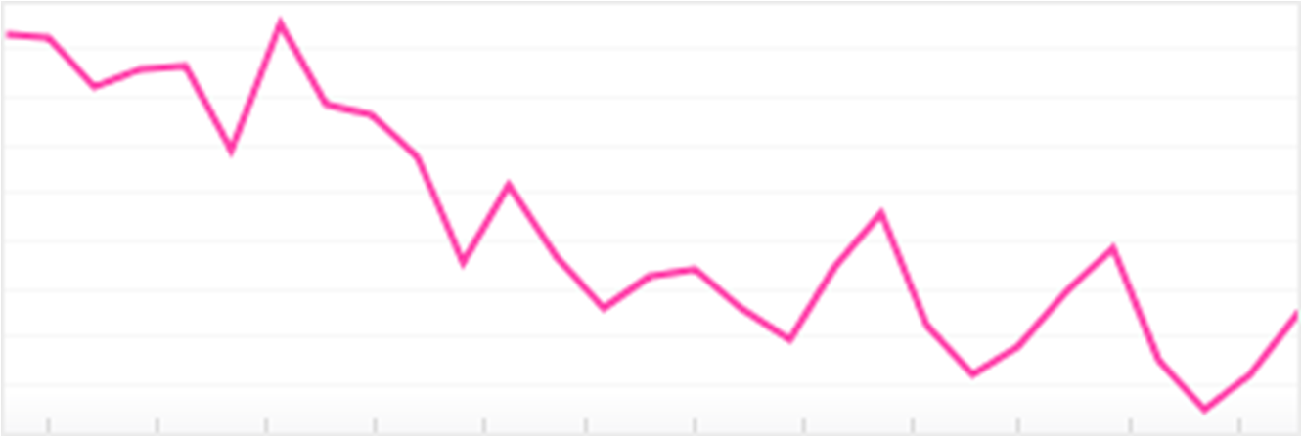
Bad Grammar → Bad Sales

Slide 30
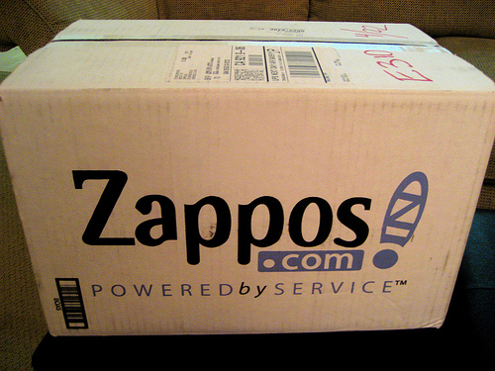
Zappos takes action!
Examined and fixed grammar for millions of reviews on Zappos.com!
Used Amazon Mechanical Turk, paying ~$0.10 per review
Improved product sales!

Slide 31
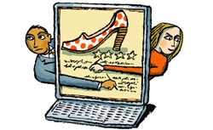
But… is it ethical?
“Would you correct a friend’s tweet or Facebook post?
…
Nitpick a colleague for using shorthand in emails sent from his iPhone?
…
This level of social intrusion is almost unthinkable.”

Slide 32
Experiment: Fixed 1000 reviews
Emailed authors: “Do you approve of the changes?”
Gift card for replying
Result: 978 replies, not a single negative evaluation!
“Thank you! I almost feel that I am ‘stoopid’ when I leave such reviews!”
“Hey, the review is not updated online! When will it be fixed?”

Slide 33
Experiment: Fixed 1000 reviews
Emailed readers: “Do you approve of the changes?”
    Version 1: Only new version posted
    Version 2: Disclaimer (“Review has been edited…”)
    Version 3: Disclaimer + mouseover to see old review
Result: For version 3, unanimously positive replies!

Slide 34
“Can you do the same for YouTube comments?
My eyes hurt every time that I read them”

Slide 35
Lesson #3
Check your gut instinct at the entrance
Measure and then talk!

Slide 36
Lessons
Measure in context: one size does not fit all
Measure what people do, not what they say
Measure!
Thank you!

